Slide 1

Engineering Employability Project
Adele Merrison
UWE Learning and Teaching Fellow
Careers Consultant

Slide 2
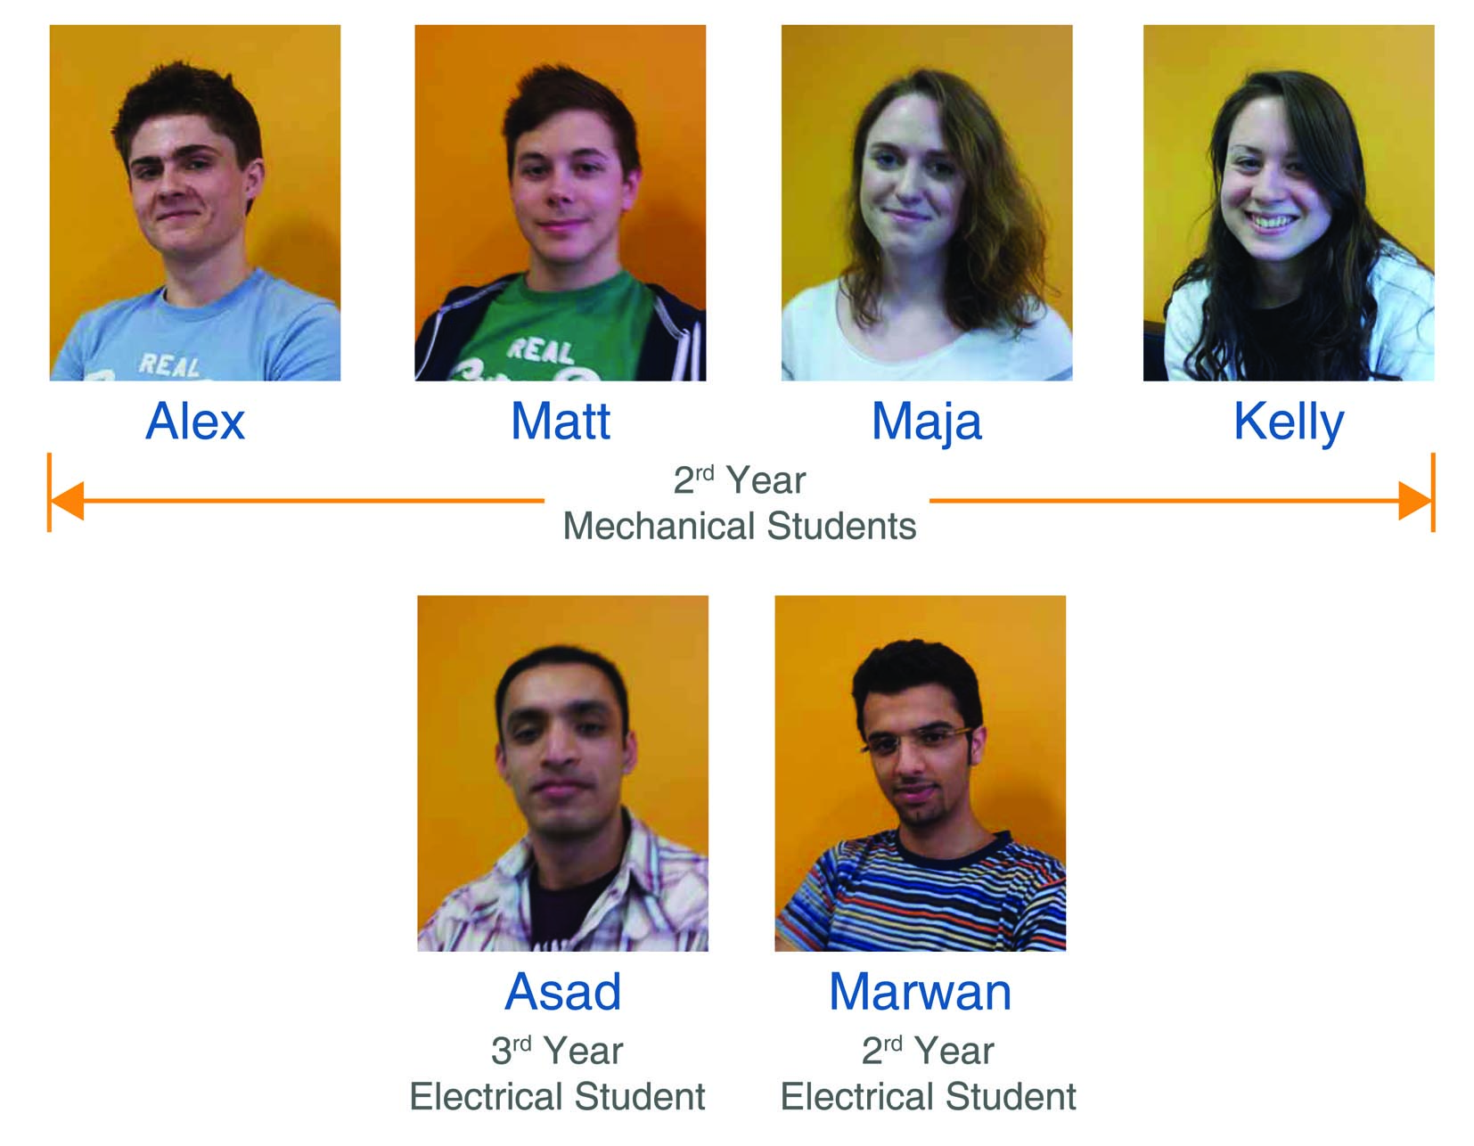

Slide 3
What we did…….
Student Led Engineering Employability Audit carried out between 7th March and 4th April 2012 by 6 students [2 electrical; 4 mechanical]
5 meetings, sector employers fair, Dropbox,
Outputs: blog, project report, dissemination events
Four strands:
Employer consultation
Mechanical and electrical engineering degrees module audit
Comparison of mechanical / electrical degrees
Personal career goals

Slide 4
How we did it differently
Engineering degrees rather than maths
Narrower focus on 5 soft skills / attributes
Employer input
Mechanical / electrical degree comparison
Personal career goals

Slide 5
Employer consultation
Sources: Infineon, Airbus, GE Aviation, Zircon, Delphi, Broadcom, Aeopona, Hewlett Packard, Intel, Stirling Dynamics, Ultra Electronics
Survey: How can these 5 soft skills/ attributes be convincingly evidenced in applications and at interview?
Method: Employers’ Fair, email, ‘phone
Outcome: a range of concrete examples……

Slide 6
Audit process
For each degree module:
Identification of current evidence gathering opportunities related to the 5 soft skills
Can it be improved?
Colour classification / grading
Suggestions for development of opportunities

Slide 7
Comparison of opportunities
Found more opportunities for electrical than mechanical students to improve their soft skills
Examples of good practice:
Discussion and reflection with tutor on the group dynamics, to improve performance
Programming - tutors give vague answers unless asked very specific questions using correct vocabulary
Labs - students are asked why they did what they did [E], as opposed to simply filling out a worksheet [M]
Use of online tests to ensure students are managing their work

Slide 8
Personal career goals?
Job profiles detailing the key skills required
How well does their degree prepare them by offering opportunities to acquire these?
What gaps if any are there? How can these be filled e.g. work experience, volunteering?
In addition to key skills covered in the audit, recognition that engineering is a global career so requires:
Language skills
Cultural competence / empathy
Flexibility e.g. living abroad

Slide 9
Recommendations
Communication
Facilitation of more technical and group discussion in a range of settings
Compulsory involvement in presentations, to ensure every team member gets an opportunity to present
Group Projects
Cross disciplinary group projects, involving members of different courses, e.g. business, economics, marketing, engineering and mathematics
Rotation of group roles to extend experience
More marks given overall to the management aspect
Professional Practice Module
Offer an optional distance learning module for students on placement

Slide 10
and some more…….
Self Management
Use a two-stage deadline in mechanical projects, to ensure students have completed the theoretical calculations and have dimensions for their physical model before they build it
Commercial Awareness
Conform to a report format used in industry
Use IET / IMechE format for group project logbooks
Give extra marks for considering cost-effectiveness or simplicity of design in production
Inclusion of an economics module to enhance students’ business awareness and understanding of profitability
Increased use of case studies of business success and failure
Question choice of components for a particular circuit design and justify going with one manufacturer over another.

Slide 11
Outputs / outcomes
Engineering Employability Project Blog
Engineering Employability Audit Report
Dissemination
Academic interest
Personal development

