Slide 1
Enhancing the employability skills of STEM student ambassadors
Emma Stephenson, Outreach & Student Recruitment Manager

Slide 2
Why we became involved
Employability is high on the agenda for all universities
Student Ambassadors are key to our Outreach and Student Recruitment work.
We were considering ways of supporting Student Ambassadors to recognise the skills acquired through the role
An opportunity to share good practice
An opportunity to work with external partners
Notes:
Karl
Why we became involved.
Recognised the need to prepare our student ambassadors for next steps
Student Ambassadors need to recognise the skills that they are acquiring whilst undertaking recruitment and outreach activities
A great opportunity to share good practice with other HEI’s and educational partners

Slide 3
Benefits beyond the initial training
For students
Supporting project delivery and development to further enhance their skills and experience
Providing role-specific examples of acquiring employability skills through the collation of case studies
For staff
Developing materials and approaches that can be embedded in the normal cycle of recruitment and training
Finding ways for Ambassadors to support project delivery and development to reduce load on staff
Sharing good practice
Notes:
Karl

Slide 4
Employability Skills are
Teamwork
Business and Customer Awareness
Problem Solving and Creativity
Communication and Literacy
Application of Numeracy
IT Skills
Positive Attitude
Entrepreneurship
Notes:
Emma

Slide 5
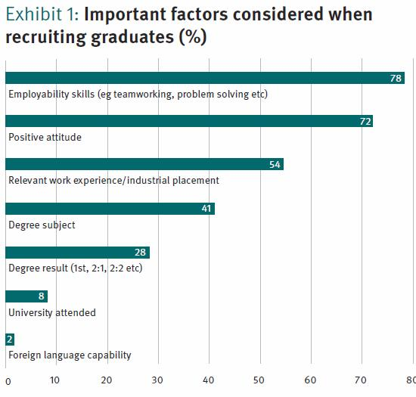
Why do you need them?
Employers look
for them
Notes:
Emma

Slide 6
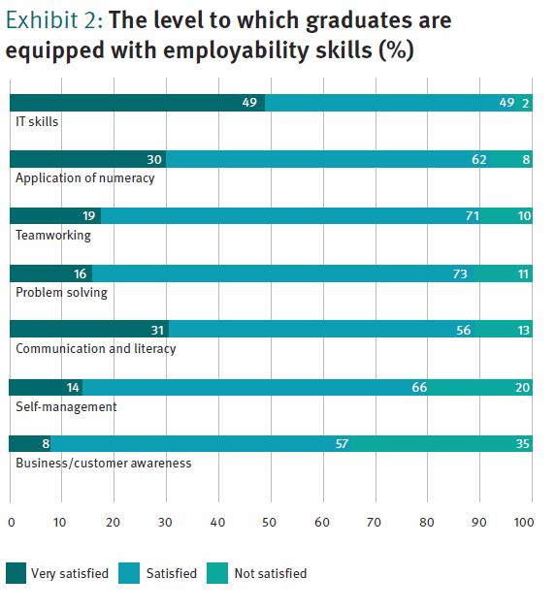
But often potential employees don’t have them
Or is it that potential employees aren’t demonstrating that they have them?
Notes:
Emma

Slide 7
Skills that employers want and how they can be developed
Personal audit of Employability Skills
Notes:
Karl
Distribute personal audit of employability skills – ask that they complete this as a student ambassador
Reflect on whether it was easy to complete

Slide 8
Job Applications
What employers are seeking on job applications
Creating a CV
Responding to advertisements
Covering letter
Notes:
Karl
Reviewed various job applications within the STEM sector
Asked student ambassadors to undertake some role play – one was the employer, one the applicant, asked student ambassadors to ask questions and consider responses.
Provided student ambassadors with a sample of what a covering letter should look like

Slide 9
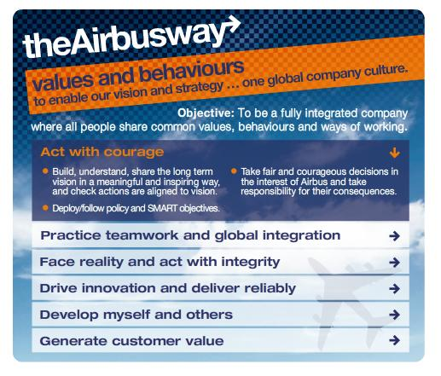
Job Applications – Airbus
Notes:
Karl
Used the Airbus job application process to illustrate the type of skills employers are seeking.
Used the personal audit of employability skills to identify how their skills could be used to illustrate the five areas sought above.

Slide 10
Evaluation and feedback
This session was:
a) Interesting | b) Informative | c) Relevant | d) Enjoyable
4.54 | 4.83 | 4.77 | 4.42
This training session:
a) Gave me a better understanding of what skills STEM employers are looking for | b) Gave me a better understanding of how the activities I undertake as a Student Ambassador have helped develop certain employability skills | c) Has given me examples and ideas about how I can articulate these skills in terms of my experiences as an Ambassador | d) Has made me more confident about providing evidence for a job application
4.66 | 4.60 | 4.65 | 4.63
Scores: 5 high - 1 low | 48 Ambassadors
Notes:
Emma

Slide 11
Future plans
Training materials will be available for other HEIs – initial session and ‘Train the Trainers’
Embedding in institutional practice for all Ambassadors
Case studies will be available to illustrate how Ambassadorial work develops identified employability skills
Case studies will be available to illustrate how Ambassadors have found the workshop beneficial
Notes:
Emma

