Slide 1


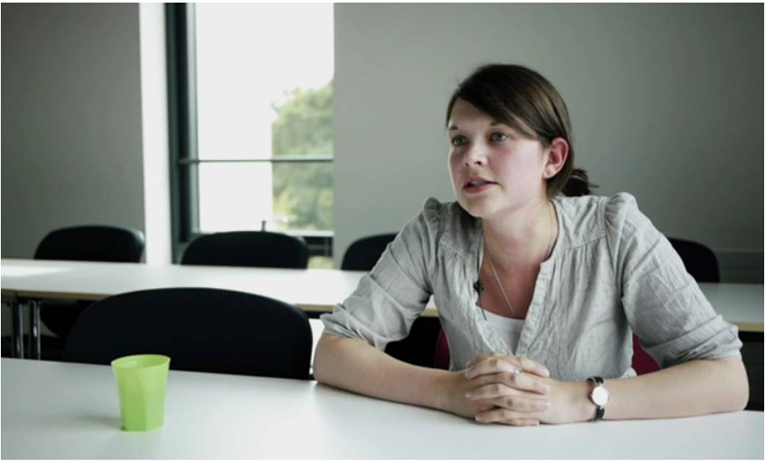
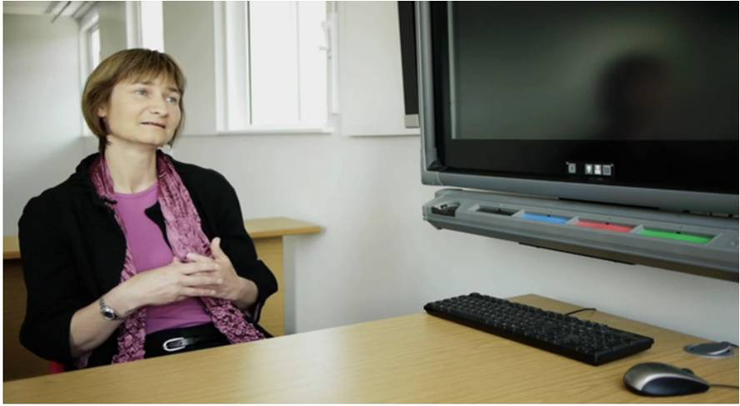
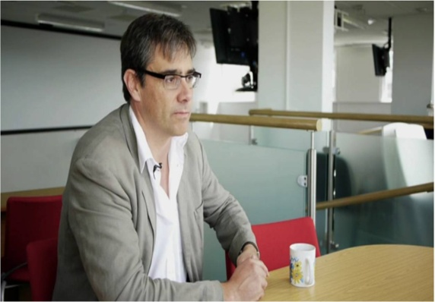
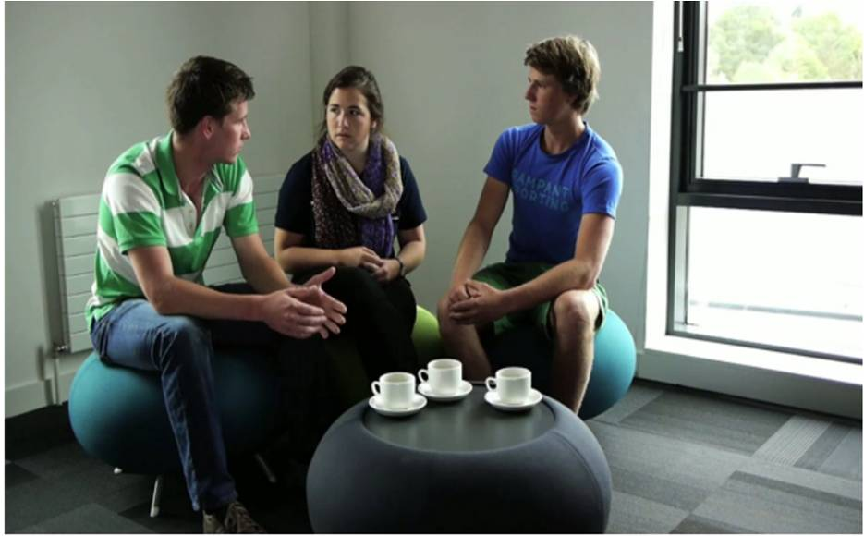
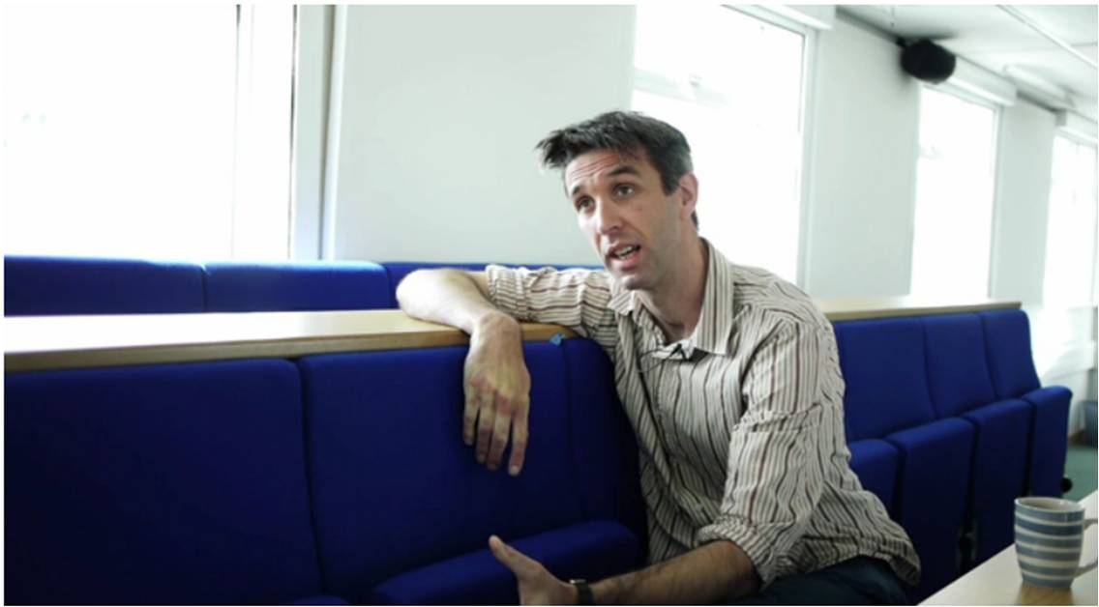
‘Becoming a STEM enthusiast’
A collaboration between Education Enhancement and the College of Engineering, Mathematics and Physical Sciences
Jane Rowe
Education Enhancement

Slide 2
STEM and WP
‘Science take-up is strongly skewed, with half of all A-level entries in science coming from 18 per cent of schools.’ (Royal Society, 2006)
‘…students at private schools are twice more likely that their peers in comprehensive schools to study mathematics at A-level.’
(HE STEM Programme, 2012)
‘Most young people have no idea what a scientist actually does, apart from possibly doctors, vets, and more recently forensic scientists (from television dramas and documentaries)’
(Royal Astronomical Society )
Notes:
Where the rationale for the project came fromL some soundbites…

Slide 3
Aim 1
To produce a range of video vignettes for use
in outreach activities
- the excitement and challenges of STEM subjects
- advice on preparing for HE level study
- relevance of STEM subjects
- application to the world of work

Slide 4
STEM and staff development
‘… for some students the route to [becoming interested and engaged in STEM subjects] will start from an experience of STEM in the wider world… thinking of STEM in school as a group of inter-related subjects helps to open up those doors… ‘
‘Inspiring teachers, sufficiently supported, are vital to raising students’ enjoyment of, enthusiasm for, and achievement in STEM subjects.’
(HE STEM Programme, 2012)

Slide 5
Aim 2
To produce a range of videos for staff
development purposes – reflections on:
- research-led teaching
- active learning
in STEM subjects
Notes:
Complementary objective to stimulate debate of learning and teaching in STEM subjects

Slide 6
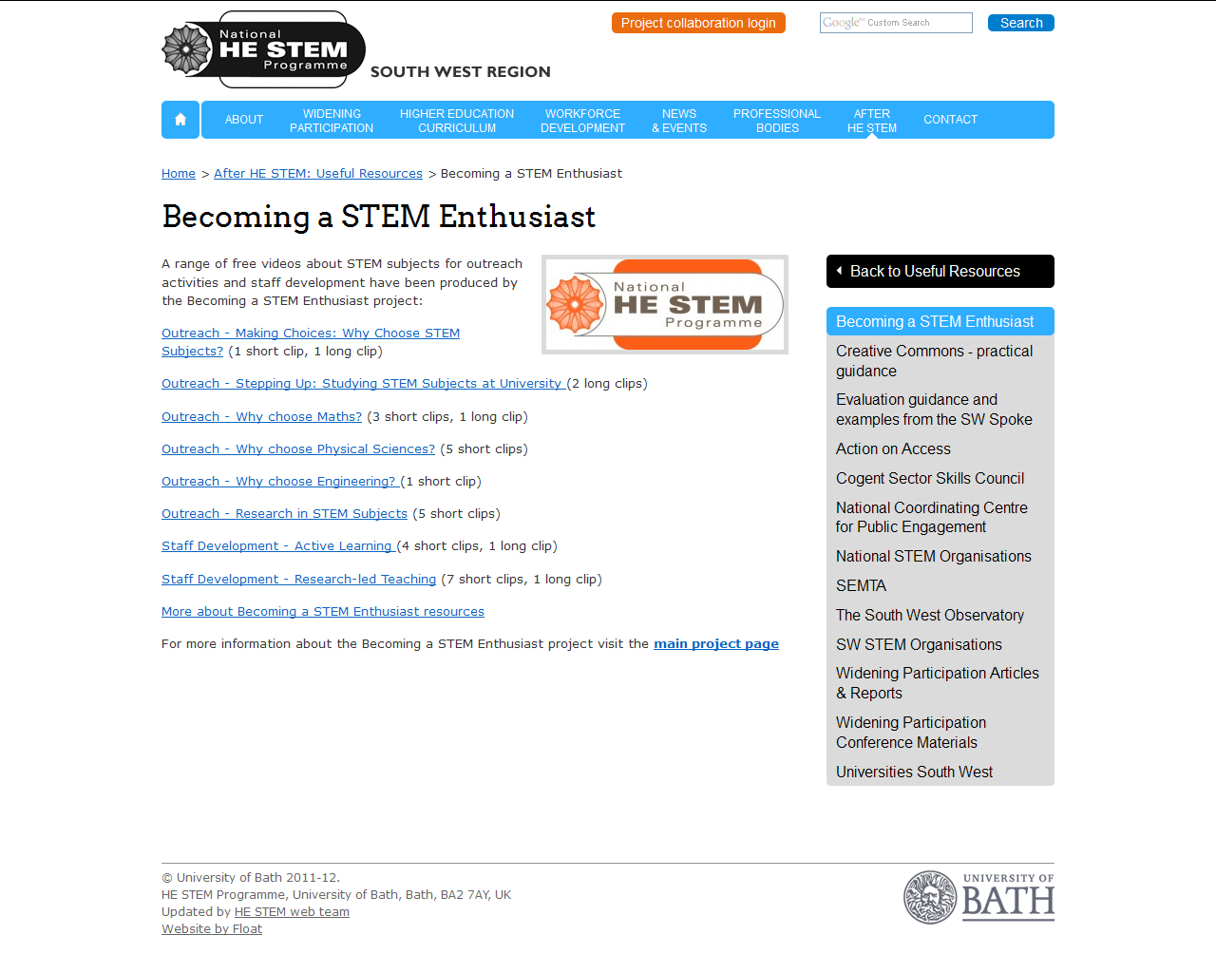
Weblink:
http://www.hestem-sw.org.uk/after-he-stem/useful-resources/becoming-a-stem-enthusiast

Slide 7
Two examples:
Dr Tim Jupp – Why choose Mathematics?
http://vimeo.com/28056387
Professor Peter Cox – Active learning in Maths
http://vimeo.com/28053486
Quick find: Go to: www.vimeo.com
Type ‘HE STEM’ into search facility

Slide 8
Dissemination
Student-facing videos disseminated so far via:
Institute of Physics – videos sent to 207 members of Schools Outreach Officers Network
Institute of Mathematics and Its Applications – videos distributed via www.mathscareers.org.uk
Career Pilot (14-19 advice on options)
SW Community of Outreach practitioners
Staff development videos disseminated so far via:
Our own courses at Exeter (LTHE for GTAs and PG Cert)
South West Educational Developers Network

Slide 9
Feedback:
A GTA response:
‘Since viewing the video, I've asked my students to come to class with two questions regarding the material they read: one question regarding something they don't understand so we can discuss it in class together, and one question they think might come up in the exam, to help them identify the main issues in the readings.’
A staff developer response:
‘We have recently been discussing the idea of some extension sessions to follow our Post- graduate Certificate in Academic Practice (PCAP) course for probationary lecturers. These videos will be excellent source material to kick off some lunchtime discussions with the new teaching staff.’

Slide 10
For more information:
Project Lead: Jane Rowe, Education Enhancement
J.L.Rowe@exeter.ac.uk)
Website:
http://www.hestem-sw.org.uk/after-he-stem/useful-resources/becoming-a-stem-enthusiast
or go to: www.vimeo.com and put HE STEM into search facility

