Slide 1


Development and implementation of a programme of employability skills for Science undergraduates
Project Leader: Louise Oliver
Faculty of Science
University of Bath

Slide 2
Project Aims and Objectives
To embed an employer-led skills development programme within STEM degree programmes
To promote further development activities available within the University
To provide access to graduate mentors
To raise students awareness of e-portfolio tools
To promote work experience and summer internship opportunities

Slide 3
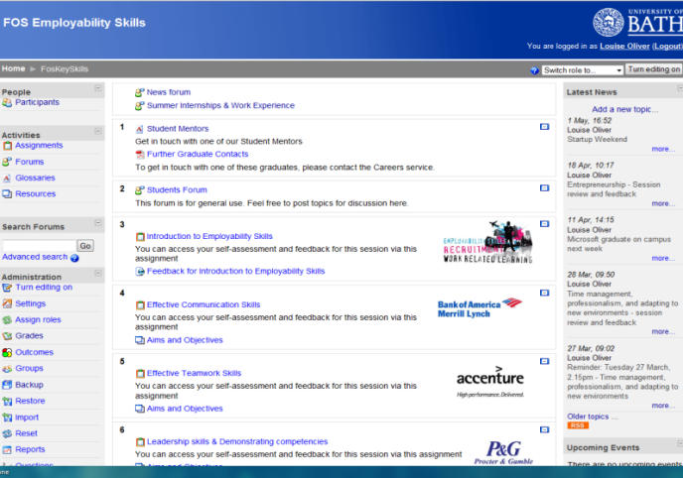
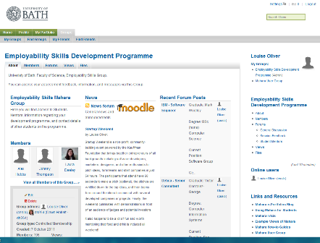
Delivery
Employability Skills development programme was embedded within the degree programme timetable
A specifically designed e-learning course was designed and developed
An e-portfolio system was made available for students use throughout the programme
A mentoring scheme was established
Employer engagement resulted in development of the programme
Learning objectives and assessment criteria were written for each session
Other relevant groups/organisations within the University engaged in programme
E-learning Course (Moodle)
E-Portfolio System (Mahara)

Slide 4
Feedback Provision: Semester 1
Level | Student Self-Assessment | Feedback
1 | Able to work in a team | We advise you to attend the Problem Solving and Decision Making session run through SORTED on 12 December at 6.15pm
2 | Able to interact with other people and to engage in teamwork with confidence, listening to and responding positively to feedback | We advise you to attend the SORTED session Negotiation skills on 14 December at 1.15pm
3 | Able to fully contribute and lead a team where necessary, building and developing appropriate relationships, recognising and respecting different perspectives whilst appreciating the benefits of being open to the ideas and views of others | We advise you to attend the Employability in an International context: Building & Motivating teams on 7 December at 3.15pm run through the SORTED programme
4 | Ability to respect others, whilst cooperating, negotiating, persuading, and fully contributing to discussions, taking a leadership role where appropriate to encourage/mentor/coach other team members | We advise you to attend the Introduction to Consultancy Skills session ran by Deloitte on 6 December at 6.15pm. This session is run through the SORTED programme

Slide 5
Skills Sessions Delivered: Semester 1
Positive Student Feedback Comments
“The quality and professionalism of the people running the lectures”
“Finding out the wide range of areas that Physics graduates can get work in”
“Information on what employers want”
Negative Student Feedback Comments
“Get rid of the clicker things”
“not interactive enough”
“More engaging, less being talked at”
Introduction to Employability Skills
Effective Communication Skills - Verbal Written: Bank of America Merrill Lynch
Effective Teamwork Skills – Accenture
Leadership skills & Demonstrating competencies - P&G

Slide 6
Skills Sessions Delivered: Semester 2
Positive Student Feedback Comments:
“Enthusiastic, interesting, worthwhile”
“useful, relevant to now”
“There were interactive parts which were useful”
“Extremely informative with relevant examples”
Negative Student Feedback Comments:
“Longer 1 to 1 interaction with speakers”
“More examples”
Employability in an International Context: Presentations Skills - Dr Margerida Dolan
Application Skills – Tessella
Time Management/ Adapting to new environments/Professionalism in the work place – Detica
Entrepreneurship - Stephen Baldwin/Tom Robertshaw/Nick Jones

Slide 7
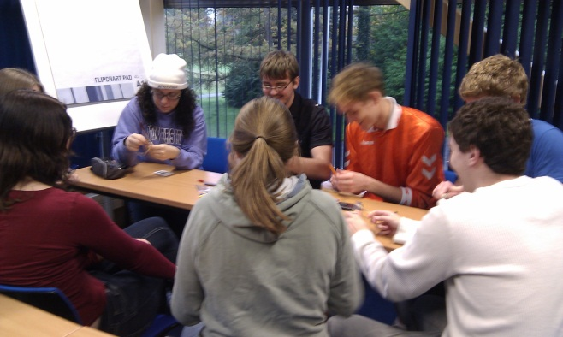
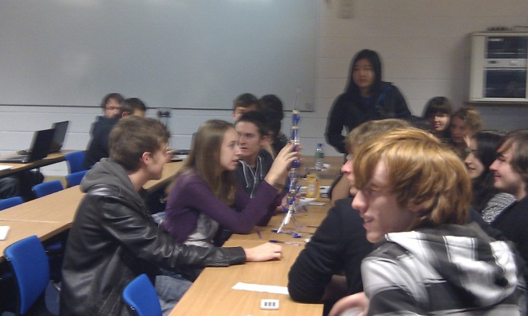
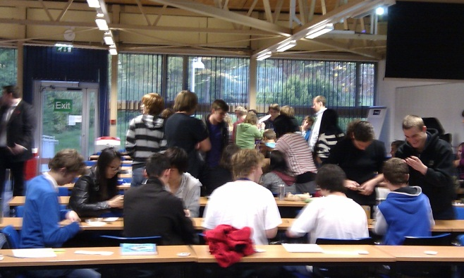
Project Findings
Sessions to be delivered by relevant employers
Sessions to include relevant industrial activities
Sessions to include opportunities available to students
E-portfolio tools to be fully integrated within the programme
Ensuring student attendance – biggest challenge!

Slide 8


The Future
Moodle Mahara/Integration
Employability Skills Audit for all STEM degree programmes
Continuance of sign-posting to relevant development opportunities
Expansion of Mentor scheme

