Slide 1

Prof Jim Griffiths
Member of the SW Regional STEM Steering Group Plymouth University

Slide 2




Project partners

Slide 3
Dr Richard Thain
Project Manager, The Hydrographic Academy
Plymouth University

Slide 4

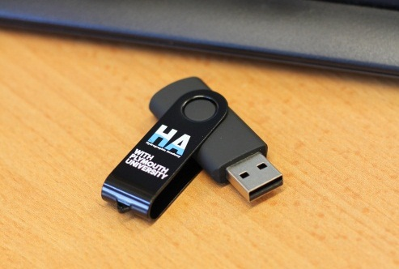
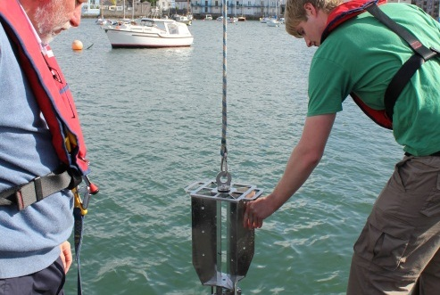
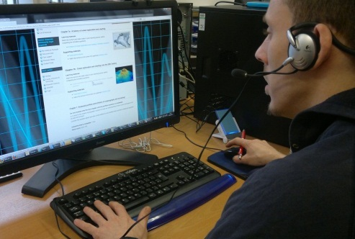
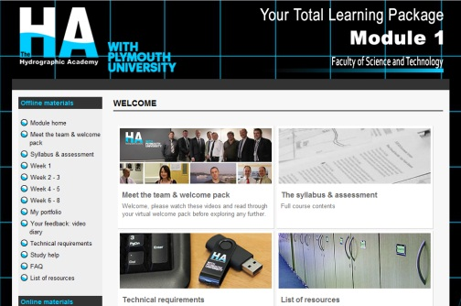

Workforce development through distance learning for the oil and gas industry
Flexible learning that fits around working patterns and location
University level qualifications and professional body recognition
Individual CPD modules, undergraduate and postgraduate qualifications

Slide 5
Market research
Trial group of students
Lessons learned
  The student experience
  The Fugro experience
  The Plymouth University experience
Feedback and questions

Slide 6
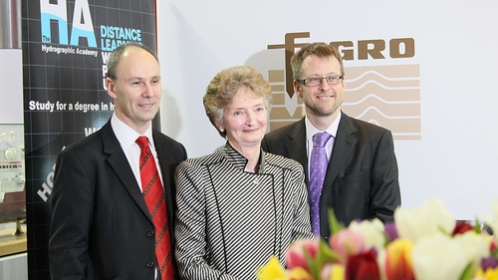
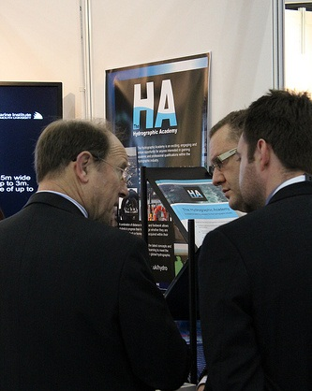
Market research
Data collection methods
  Industrial partner
  Register interest
  Conferences
  Group of trial students

Slide 7
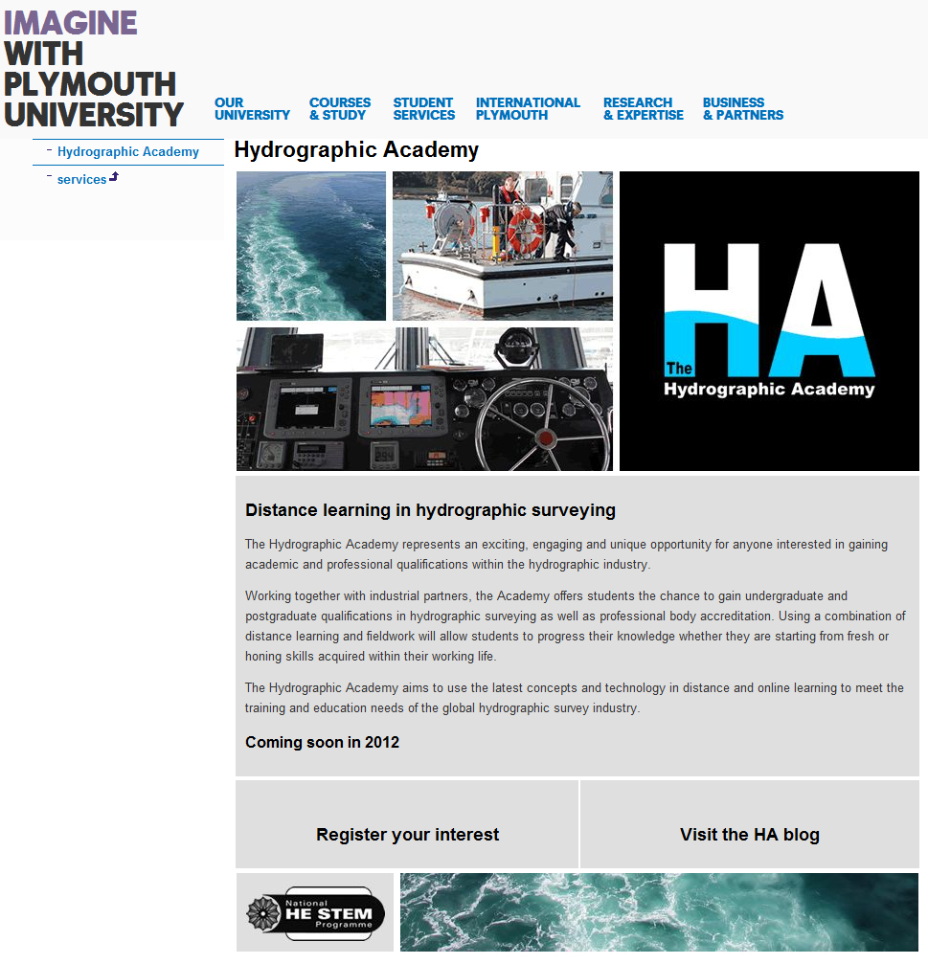
www.plymouth.ac.uk/hydro

Slide 8
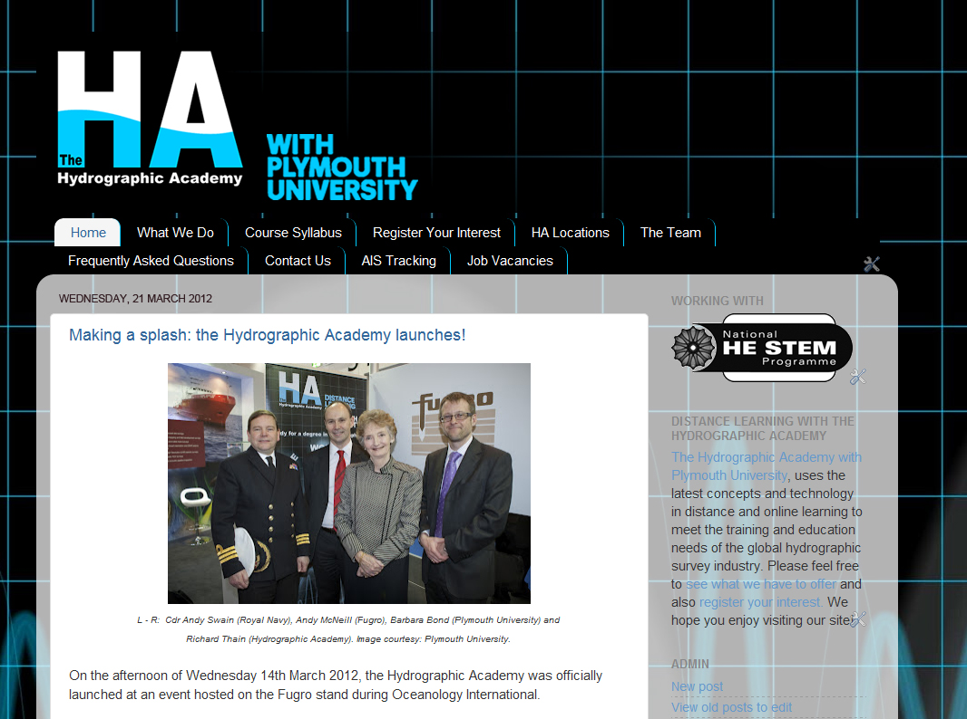
www.plymouth.ac.uk/hydro

Slide 9
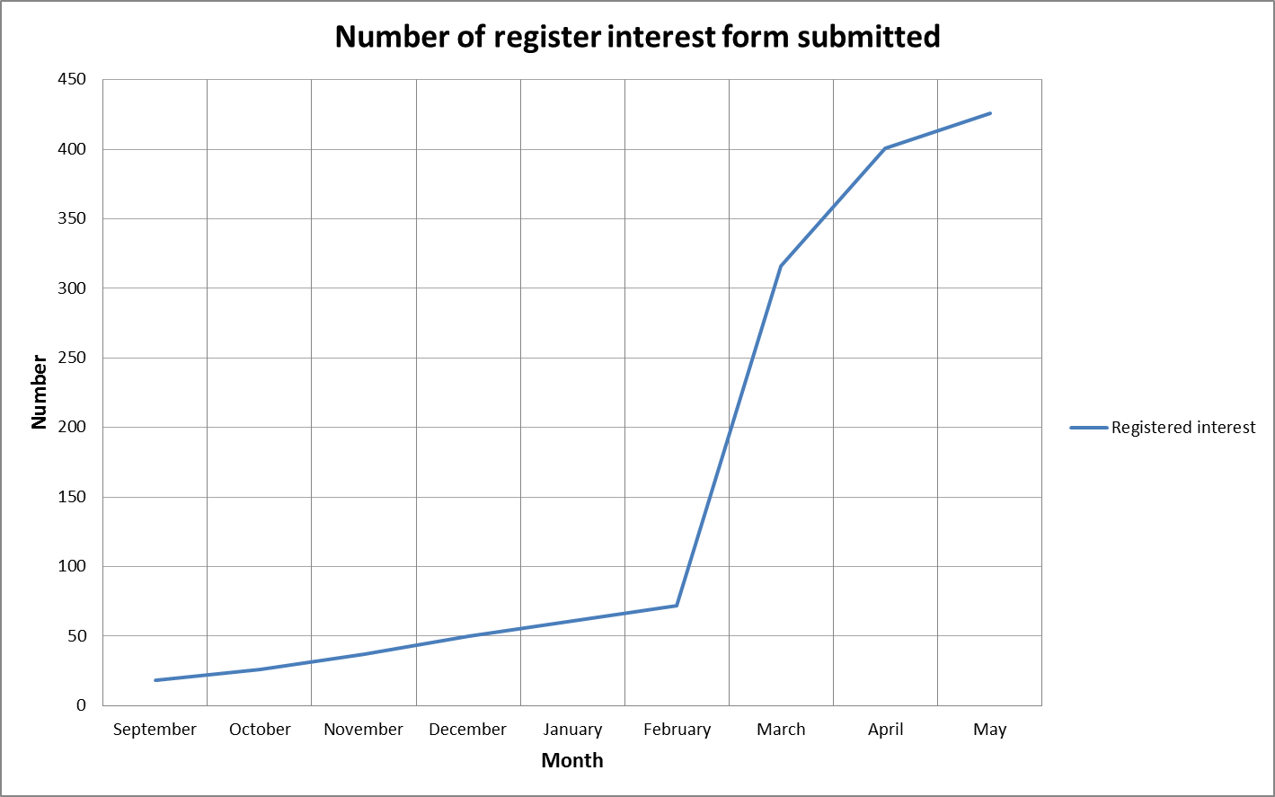
Graph of registered interest*
Oceanology International 2012
*All registrations as of 23/05/12

Slide 10
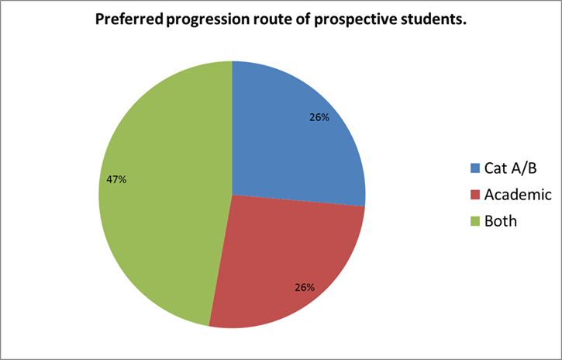
Preferred progression route of prospective students*
*All registrations as of 23/05/12

Slide 11
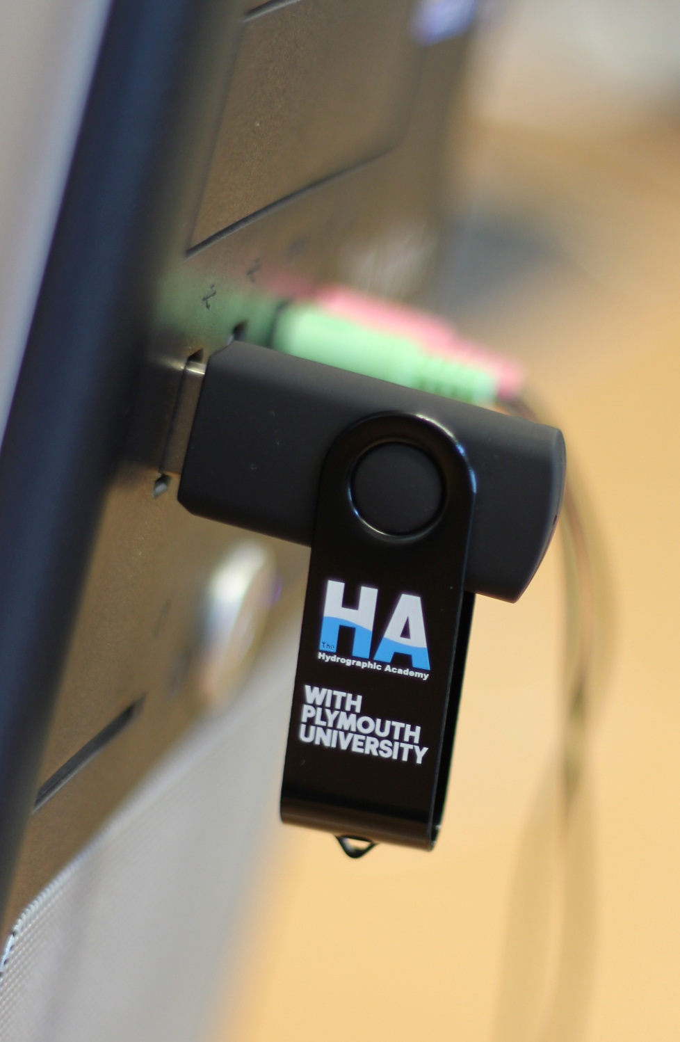
Course materials contained on a USB stick
Need for an internet connection?
Tutor support by email/Skype
Online discussion and student support area
Syllabus development?

Slide 12
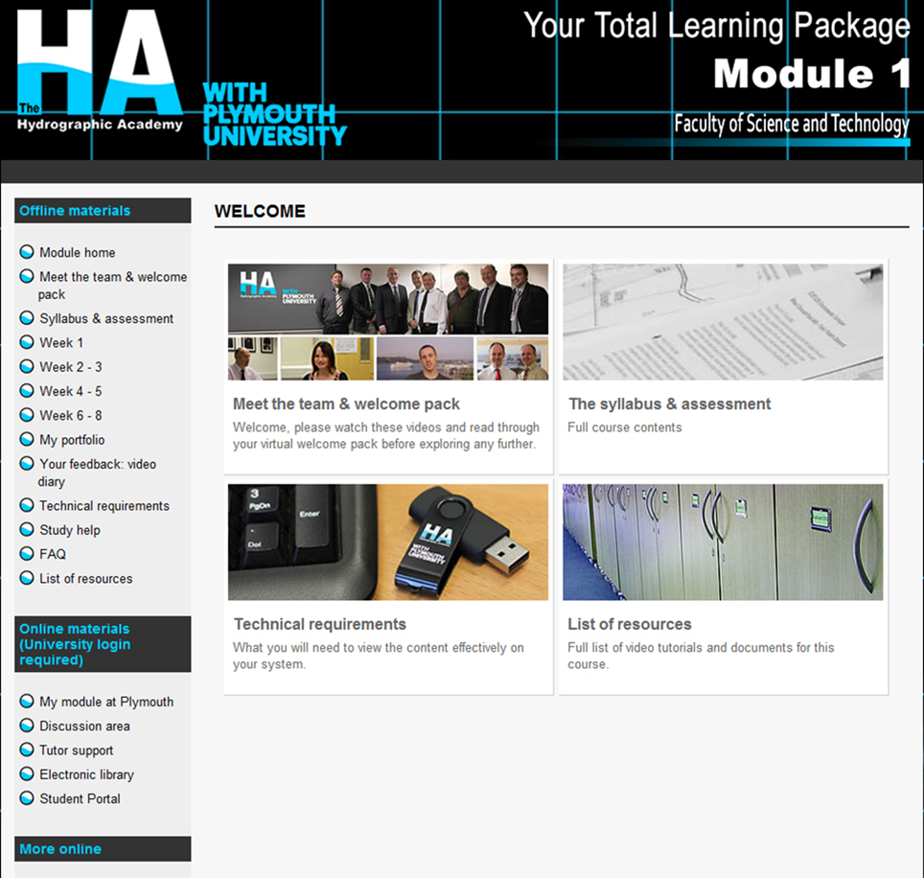

Slide 13
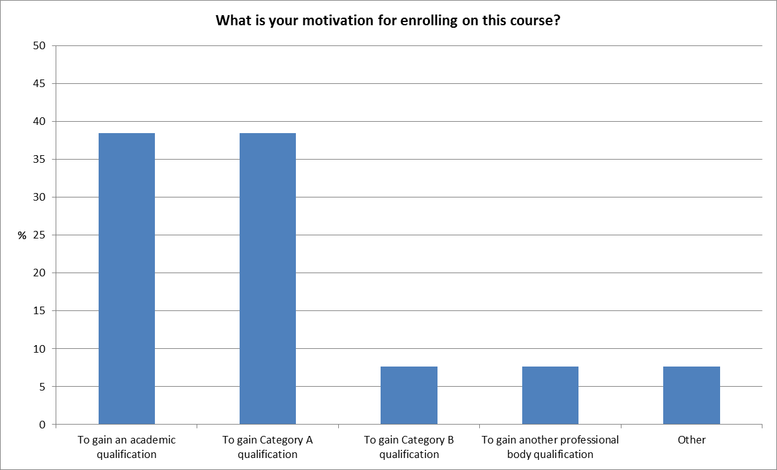
The student experience
Data from Module 1 student trial

Slide 14
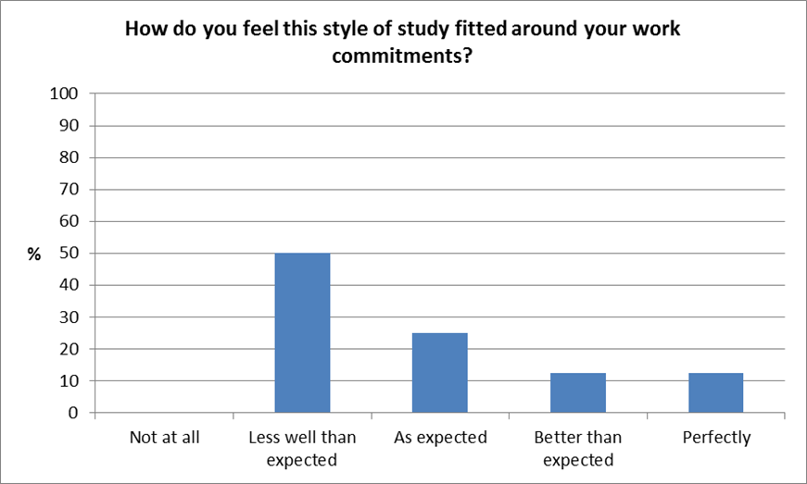
The student experience
Data from Module 1 student trial

Slide 15
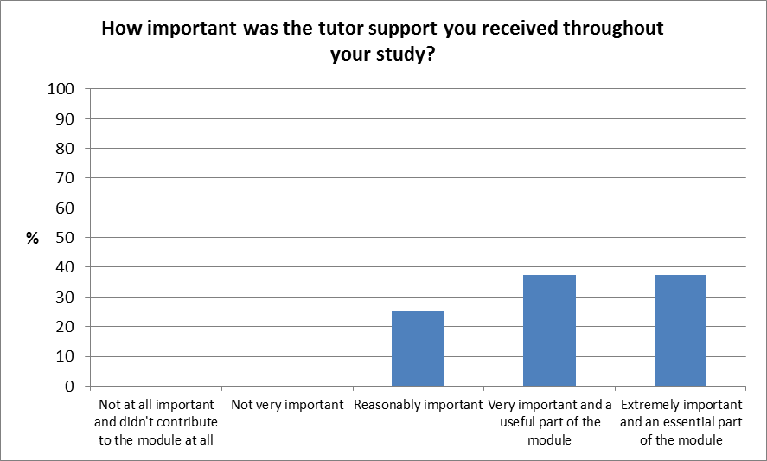
The student experience
Data from Module 1 student trial

Slide 16
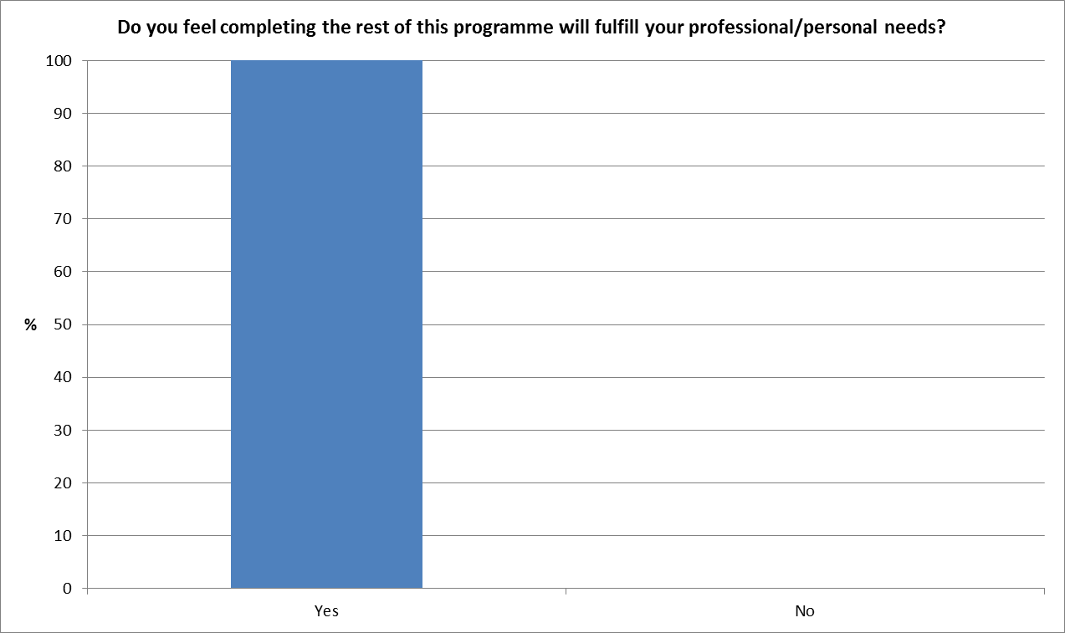
The student experience
Data from Module 1 student trial

Slide 17
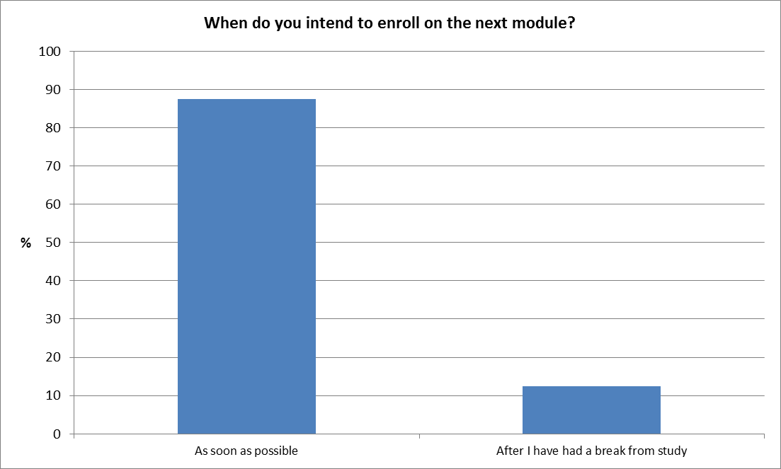
The student experience
Data from Module 1 student trial

Slide 18
Recruitment, timeline and numbers
Over 420 have registered an interest
Recruiting 120 students over the next 12 months
First graduates expected 2015
Steady state?
  Expecting to deliver >60 graduates per year from both programmes

Slide 19
Lessons learned
Industrial partner involvement
  Syllabus and advice
  Professional bodies
  Marketing
  Students
Market need
Professional bodies
STEM funding critical as ‘seed’ money
Communication, time and project management

Slide 20
The student experience – a STEM success story
“I have quite literally searched the world for an institution that offers this kind of tertiary education and from Australia to Europe I have been unsuccessful so thank you for your efforts! It's a huge step in the right direction!”

Slide 21
The student experience – a STEM success story
“The course syllabus looks great! Establishing the Hydrographic Academy is a great initiative!”
“It’s great to have all the materials to be able to access the lectures and notes as and when I have time. It’s very comprehensive, there are a lot of materials and it’s a great opportunity for me to be able to study like this.”

Slide 22
The student experience – a STEM success story
“The content is easy to navigate through and it is very impressive. I was thinking there may be some key areas where I would need some extra information but that wasn’t the case. I am very impressed with the course content and materials”
“The Hydrographic Academy has given me the chance to fill a gap in my CV and develop my theoretical knowledge whilst helping me to progress my career within the industry”

Slide 23
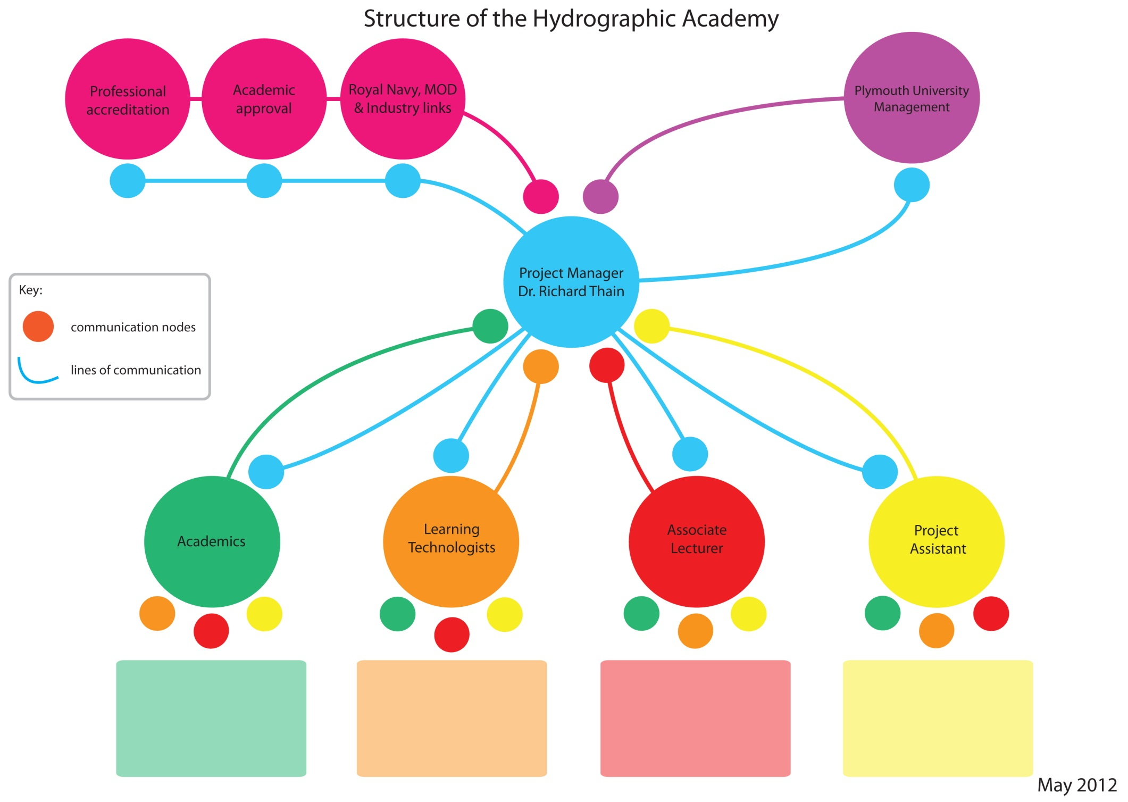
Anthony Jenks
1x academic to be recruited
Dr. Jason Truscott
Jonathan Scott
Rebecca Vickerstaff
Luke Denner
To be recruited as required
Currently being recruited

Slide 24



Slide 25
DipHE Hydrography for Professionals
Entry
(Level 4)
Stage 1 – Level 4
Stage 2 – Level 5
Stage 3 Level 6
U3
CertHE Award
IHO CAT B
+ DipHE Award
Nautical science
U6
Hydrographic survey management and charting
Route to
BSc/hons
Full time study or part time study outside the HA
1
30 Credits
30 Credits
Mandatory introductory module
'An Introduction to Hydrography and the Marine Environment'
Fundamentals of Hydrographic survey practice
Meteorology and oceanography
U2
U4
U5
Underwater acoustics and sonar
Work-related project, based on IHO optional units
U7
30 Credits
30 Credits
30 Credits
40 Credits
10 Credits
Practical hydrographic surveying 1
(2 week residential+exams)
UR1
Practical hydrographic surveying 2
(2 week residential+exams)
UR2
20 Credits
20 Credits
10 Credits
110 Credits
120 Credits
80/120 Credits

Slide 26
PGDip Hydrography for Professionals
Direct Entry
Hold an appropriate undergraduate degree and relevant experience. Must
Complete mandatory introductory module
'An Introduction to Hydrography and the Marine Environment'
Level 7 – PG Cert
Level 7 – PG Dip
Level 7 MSc
Review and approval by course team
PGCert Award
IHO CAT A
+ PGDip Award
Earth science for hydrography
Advanced techniques in hydrography
P3
P5
MSc dissertation (based on IHO optional units)
P6
20 Credits
20 Credits
10 Credits L4
Advanced hydrographic survey practice
P2
P4
Advanced underwater acoustics
Progression from CAT B
At least 5 years’ professional experience working in industry and submission of a portfolio of evidence, or
Completion of Level 6 through full time or part time study outside the HA
20 Credits
20 Credits
Practical hydrographic surveying 2
(2 week residential+exams)
Practical hydrographic surveying 1
(2 week residential+exams)
PR2
PR1
20 Credits
20 Credits
60 Credits
60 Credits
60 Credits

