Slide 1

CRM System
Dr Ross Kay
Weymouth College

Slide 2
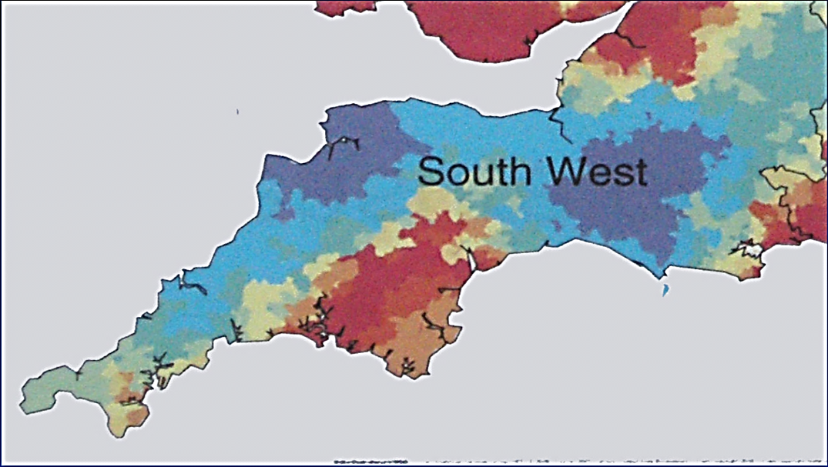
Context and Rationale
Weymouth

Slide 3
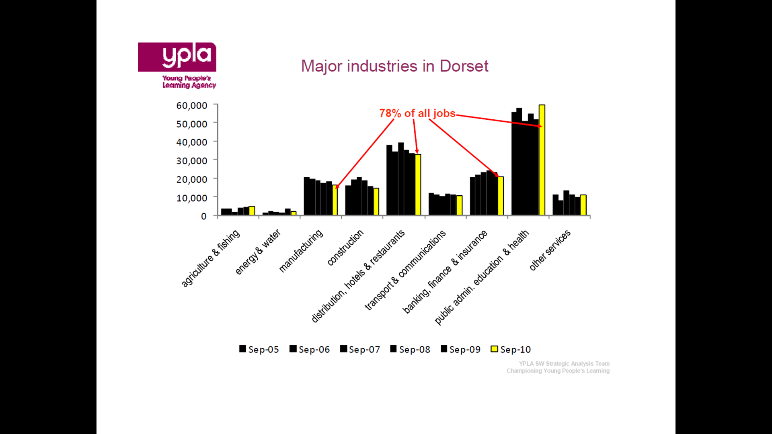
Employment

Slide 4
Opportunity
500 employers engaged annually
Retiring population in ex-MOD organisations and spin-offs
Higher Apprenticeships?
Existing longstanding relationships between the College and HEIs
HE STEM Project!

Slide 5
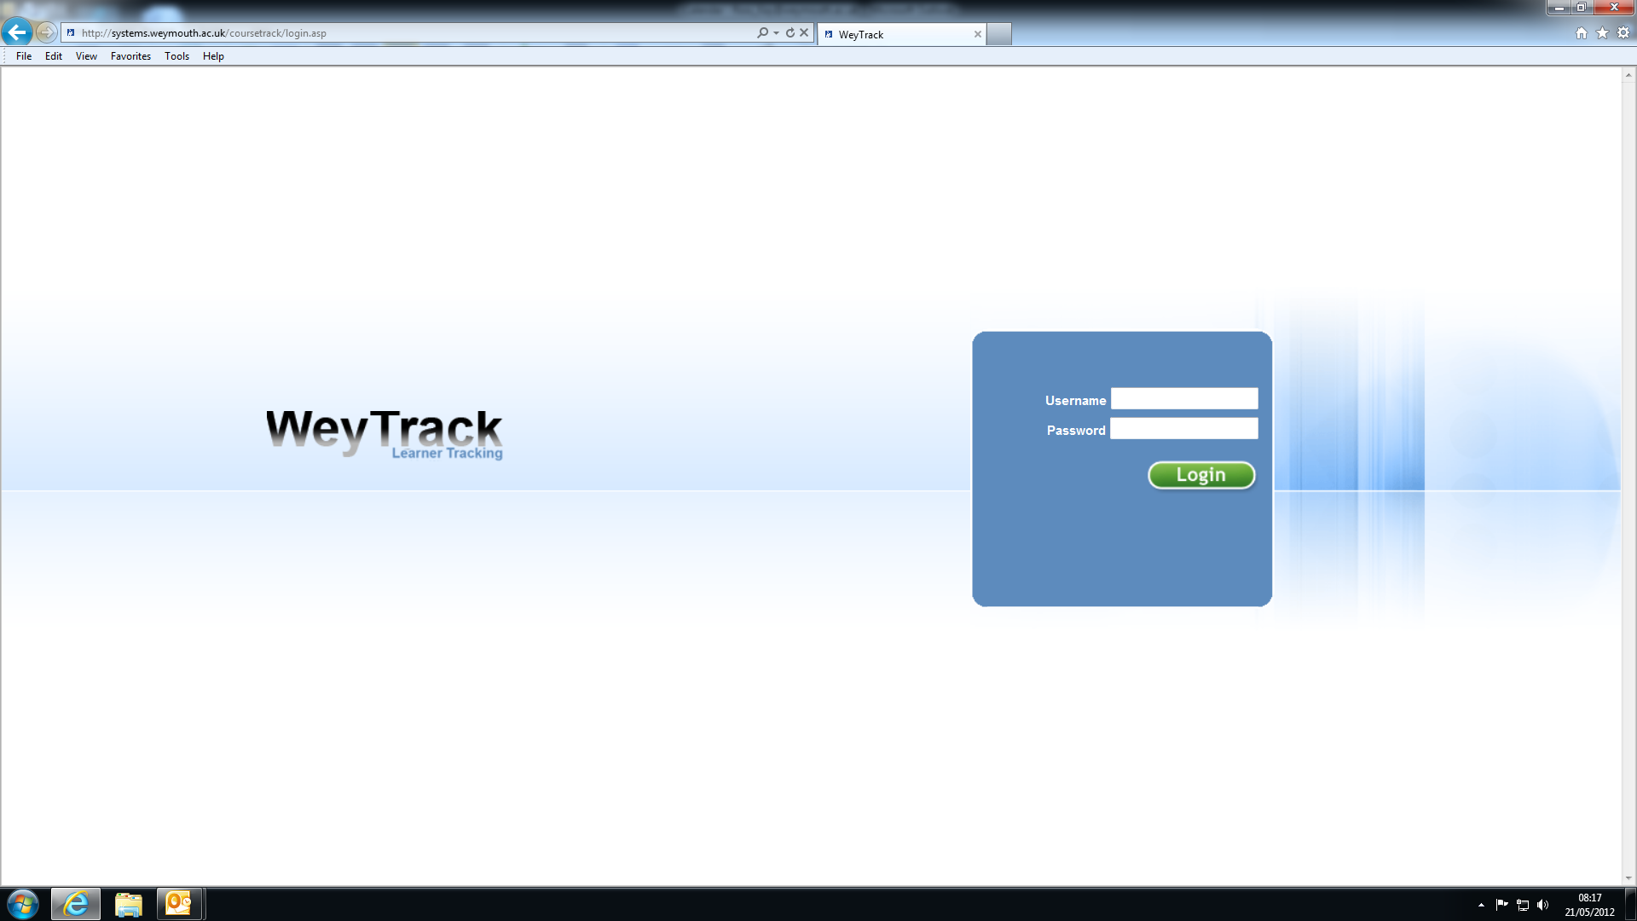

Slide 6
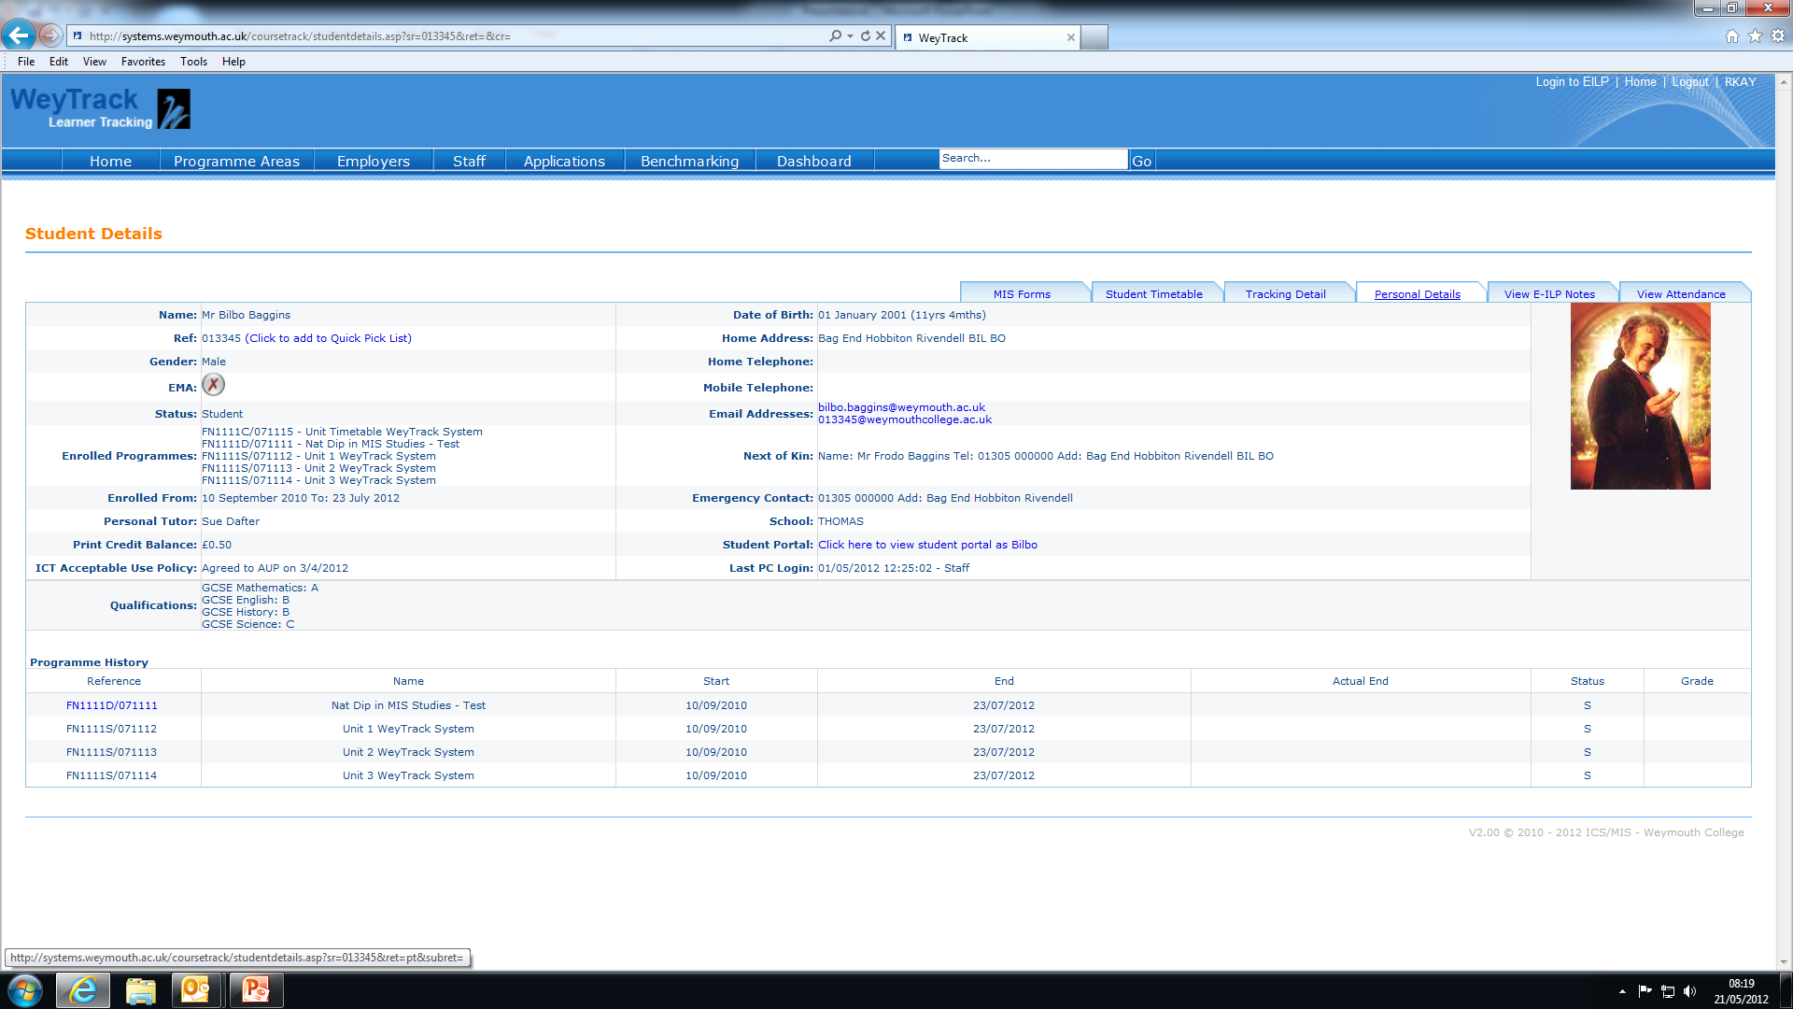

Slide 7
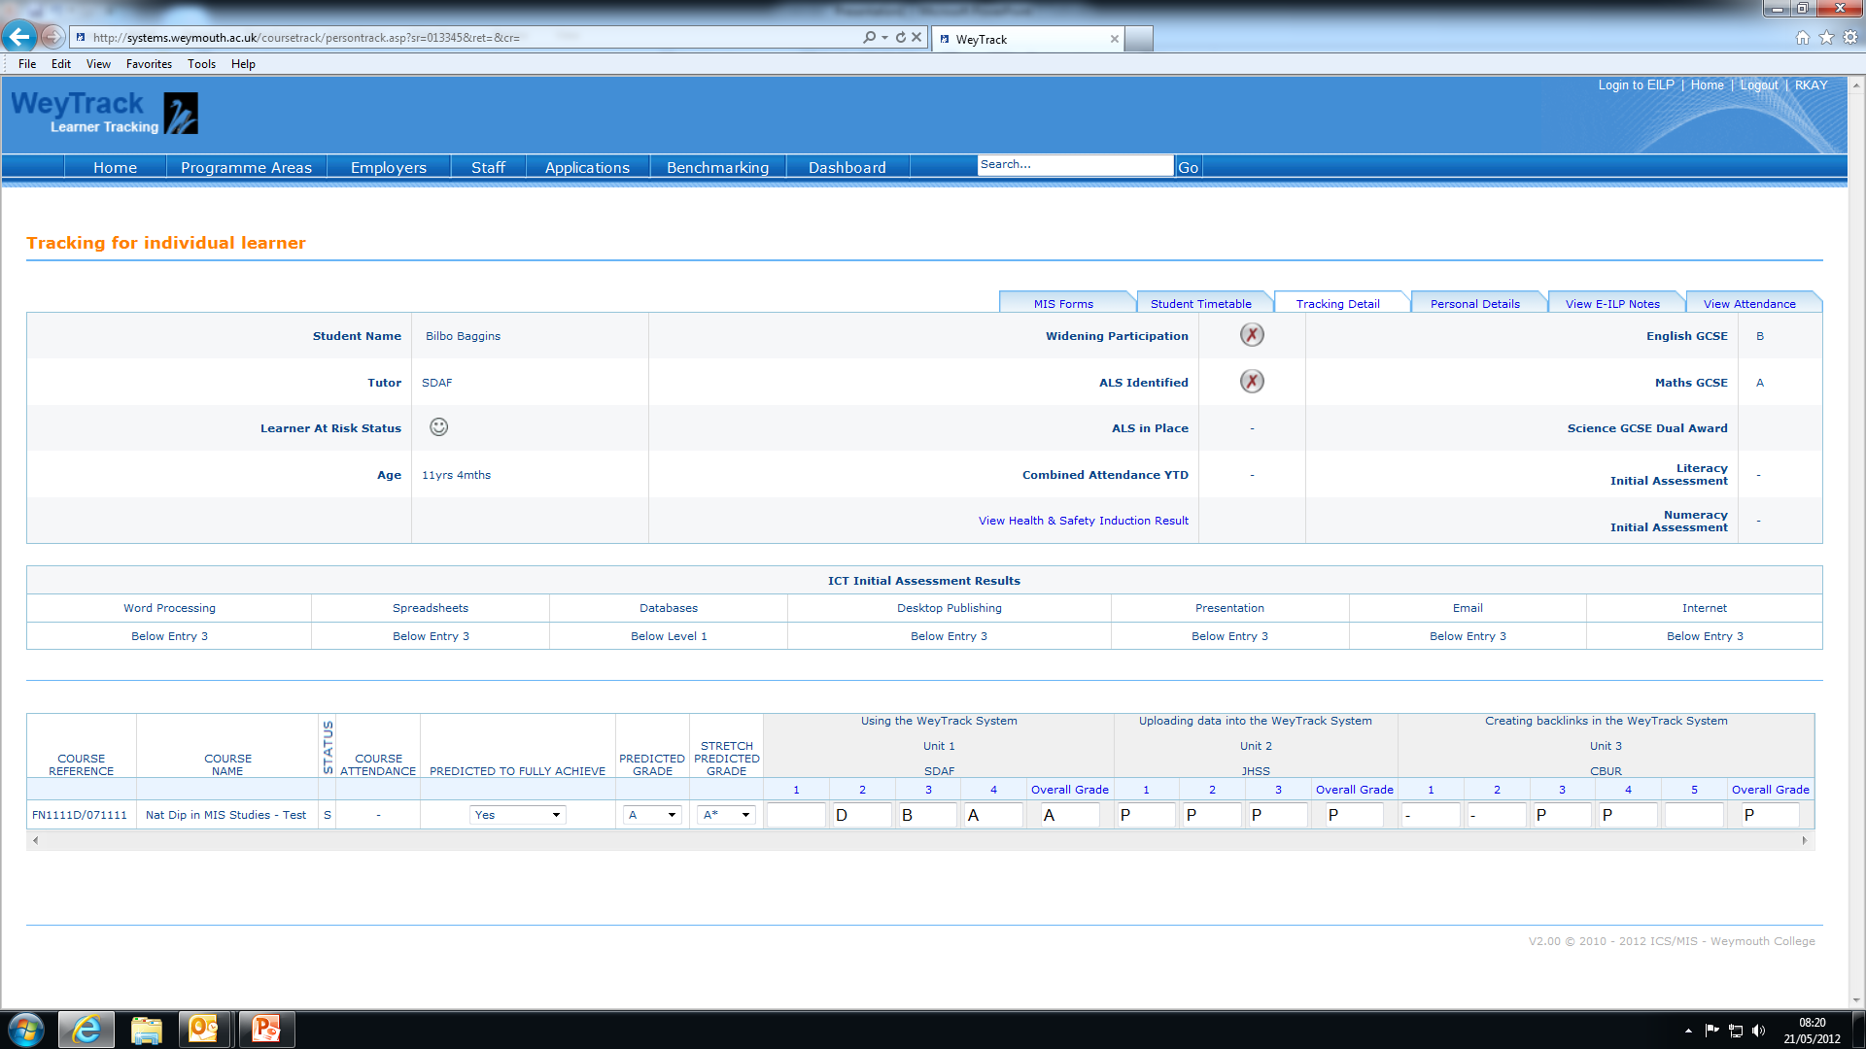

Slide 8
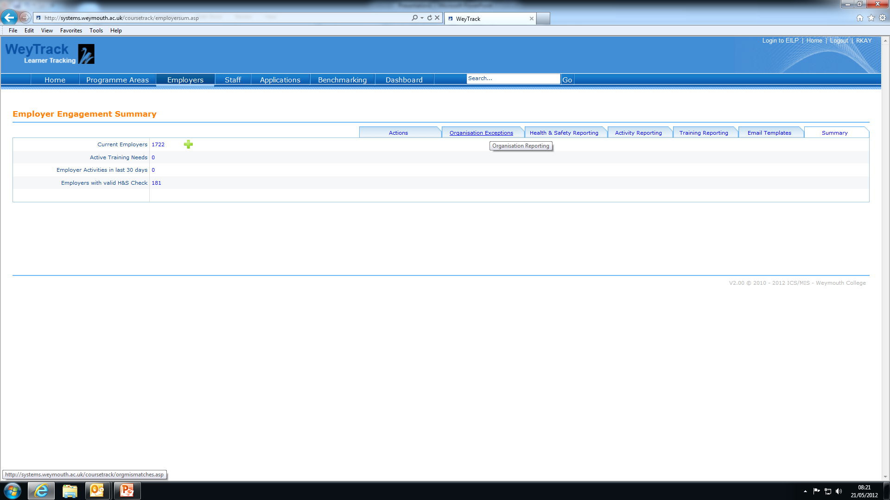

Slide 9
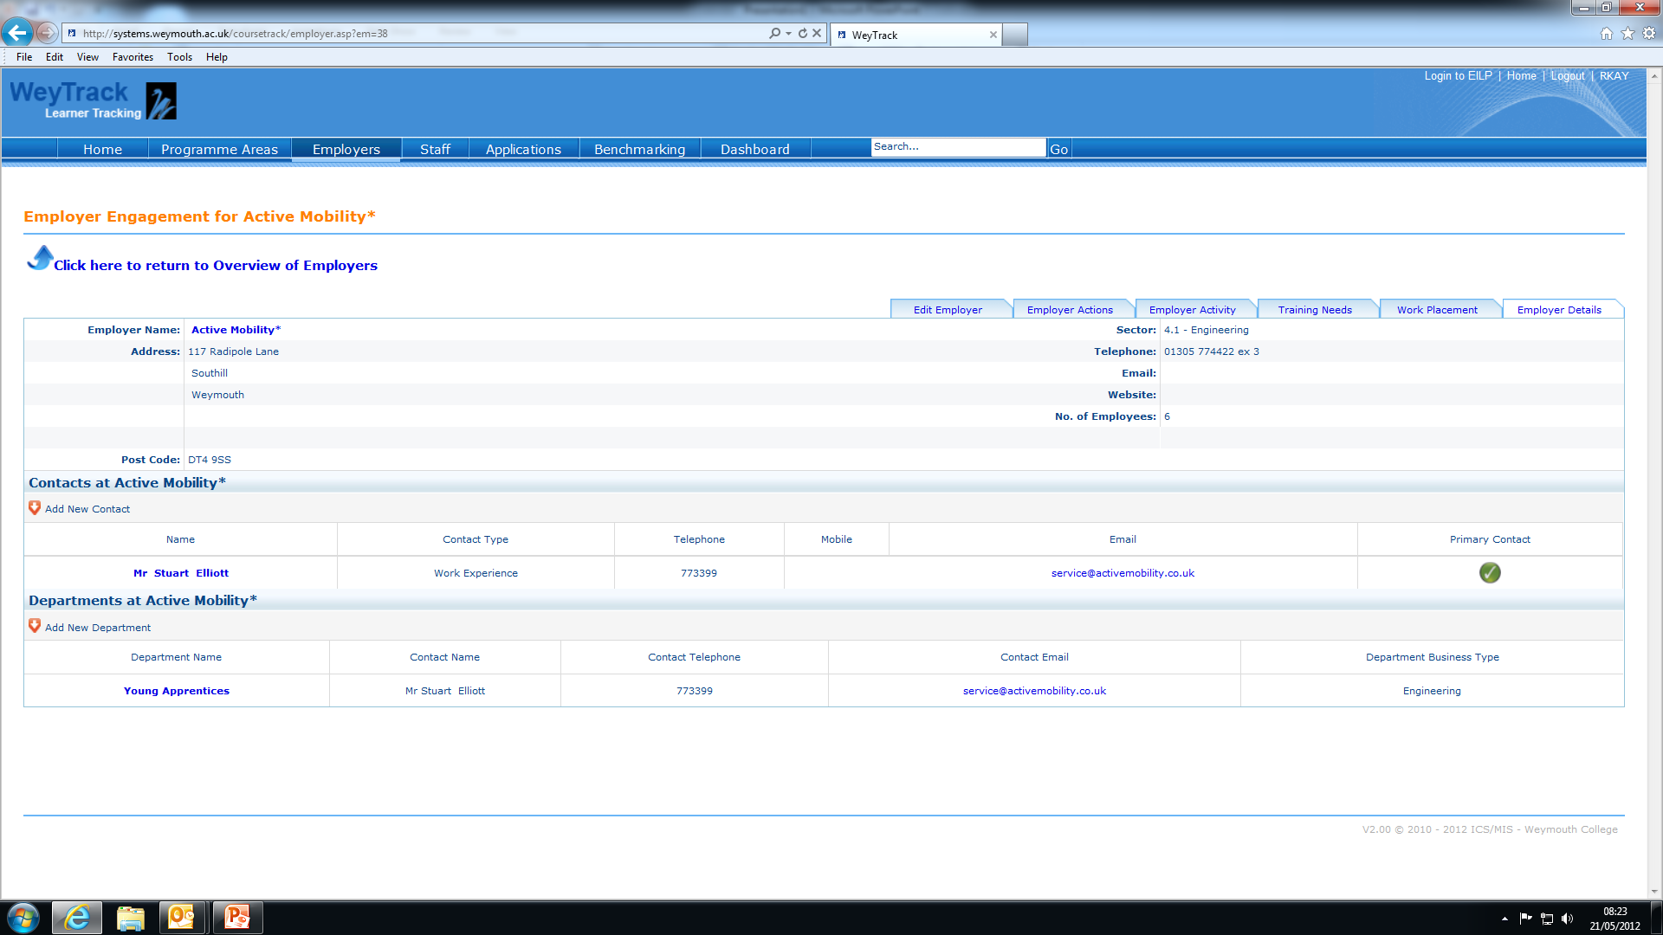

Slide 10
List of Outputs:
A learner and CRM integrated system for the management of interactions with SMEs
Labour Market Intelligence concerning (LMI) the main barriers to engagement with HE in semi-rural locations, geographically isolated from HEIs
New proposals for HE delivery to meet the needs of local Engineering SMEs including content and delivery methodology

